Slide 1

EzRezipe
Developed By:-
Amrita Sodhi [N01513240]
Karan Punjabi [N01514624]
Remya Raj [N01513680]
Richu Thankachan [N01516068]

Slide 2
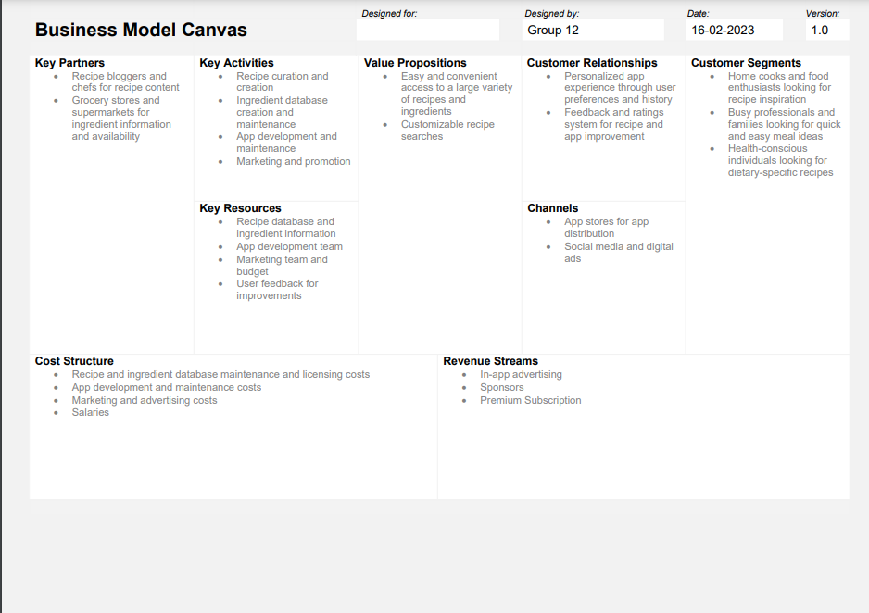
MILESTONE 1

Slide 3
MILESTONE 2
In milestone 2 we have developed the UI prototype.
Created the wireframes in Figma and created views within the Xcode.
Once completed developing we have exported the wireframes into Figma, then to Zeplin and then to Xcode.

Slide 4

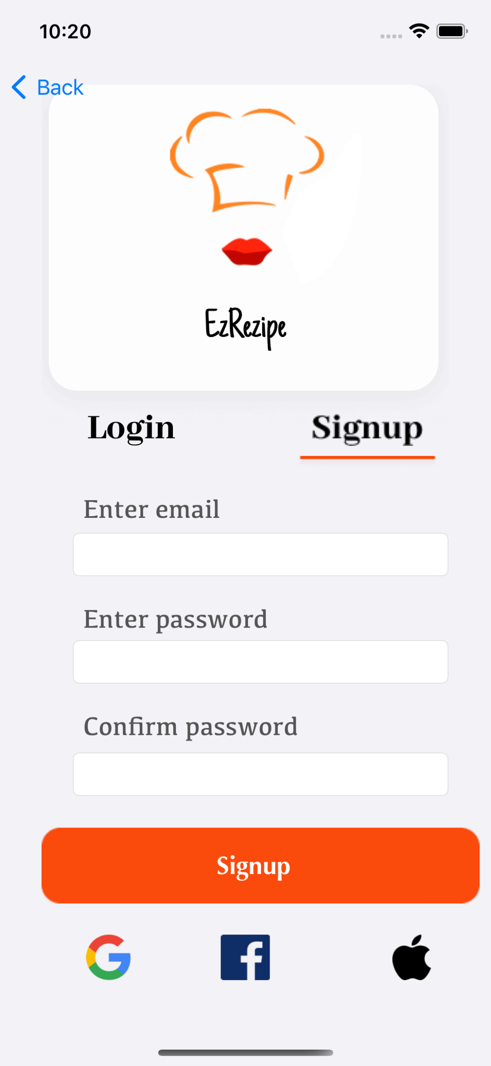
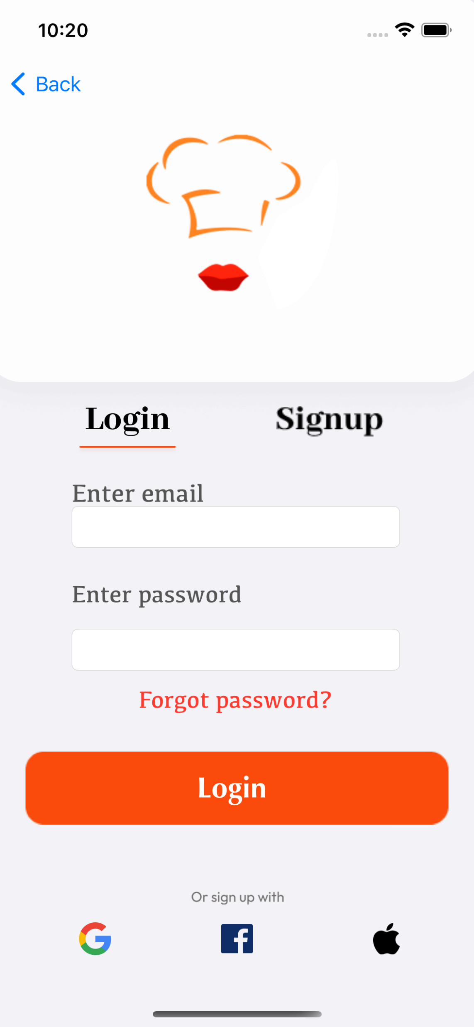
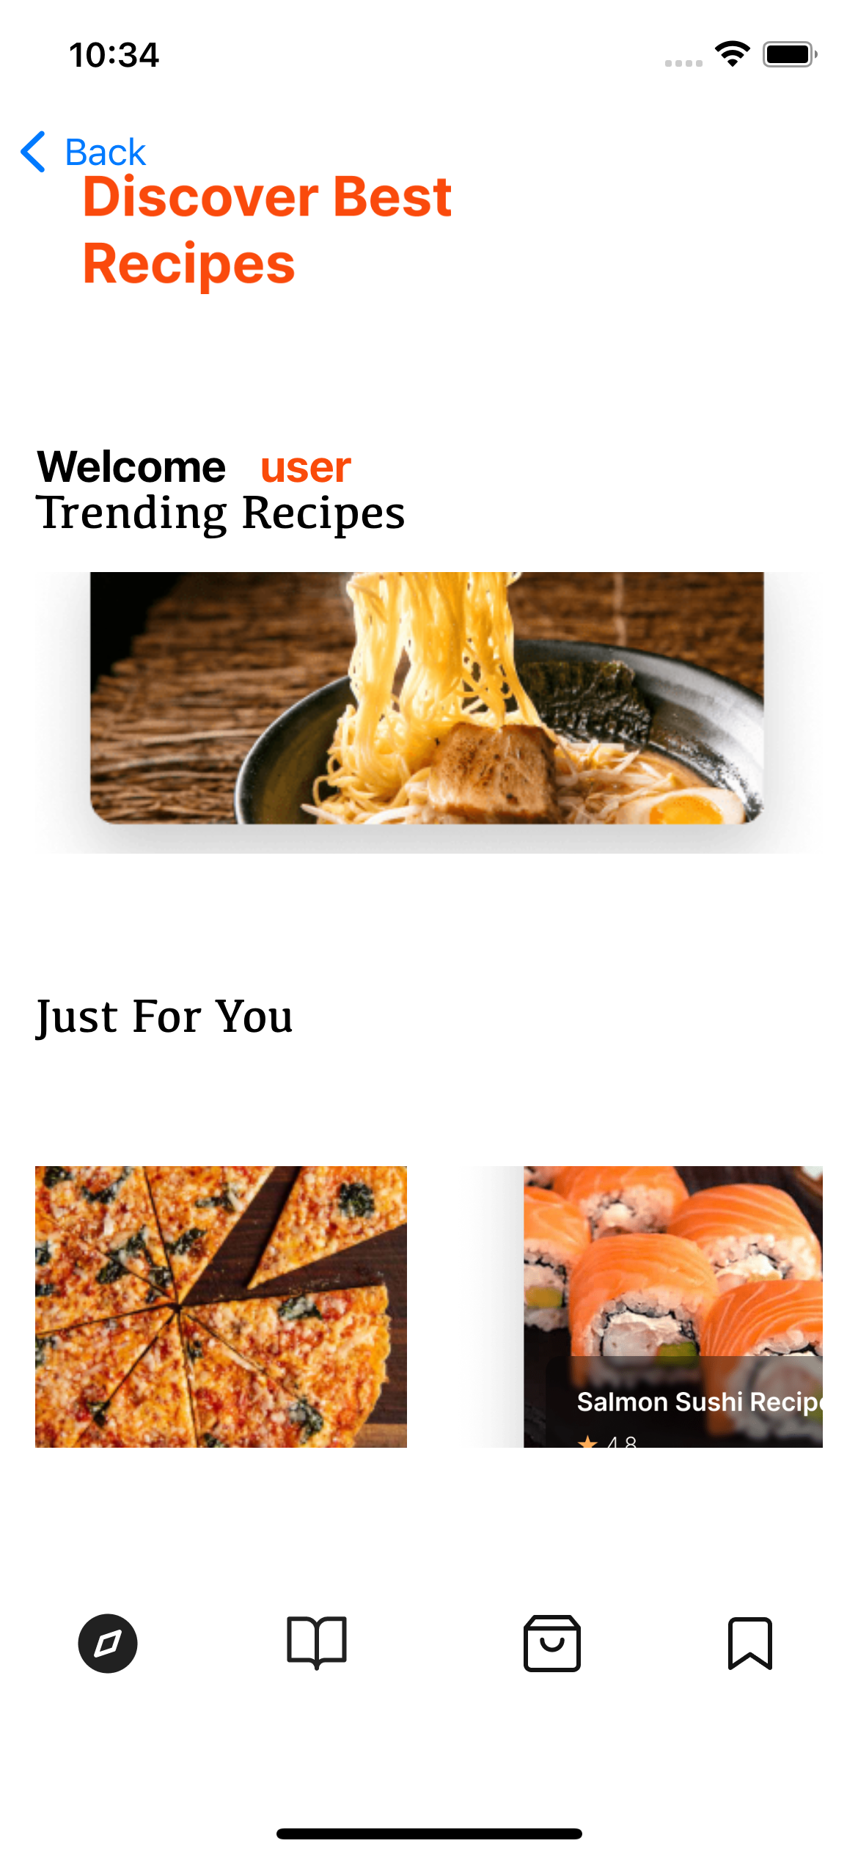
MILESTONE 3

Slide 5
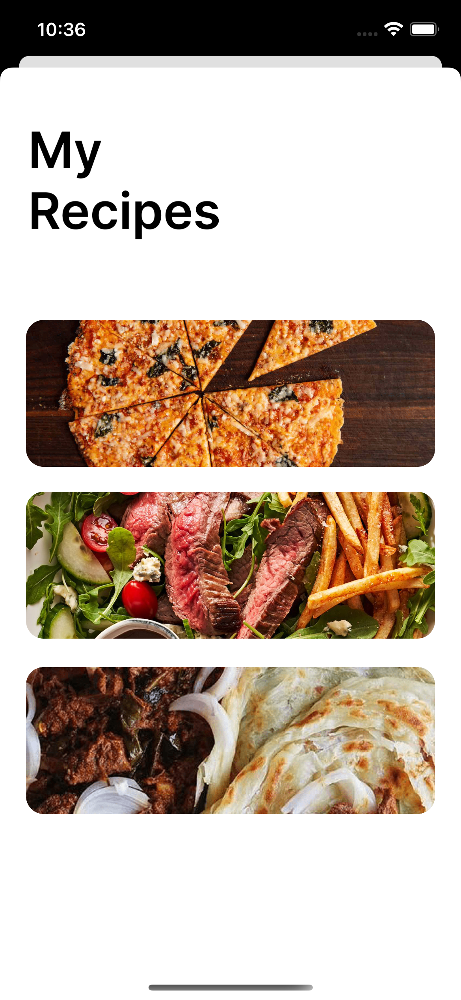
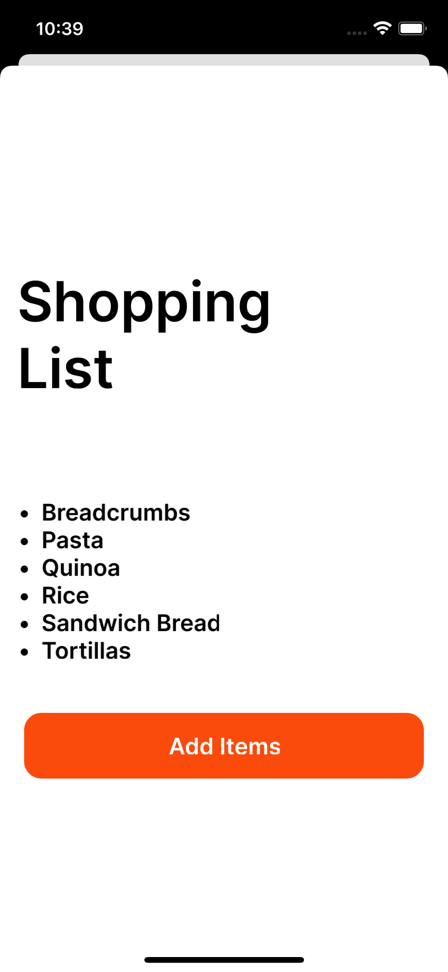
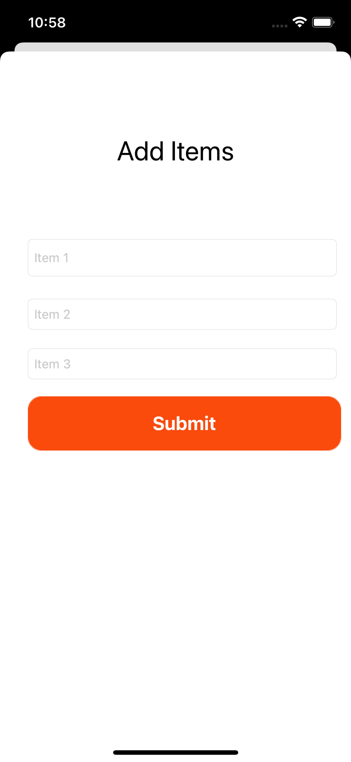
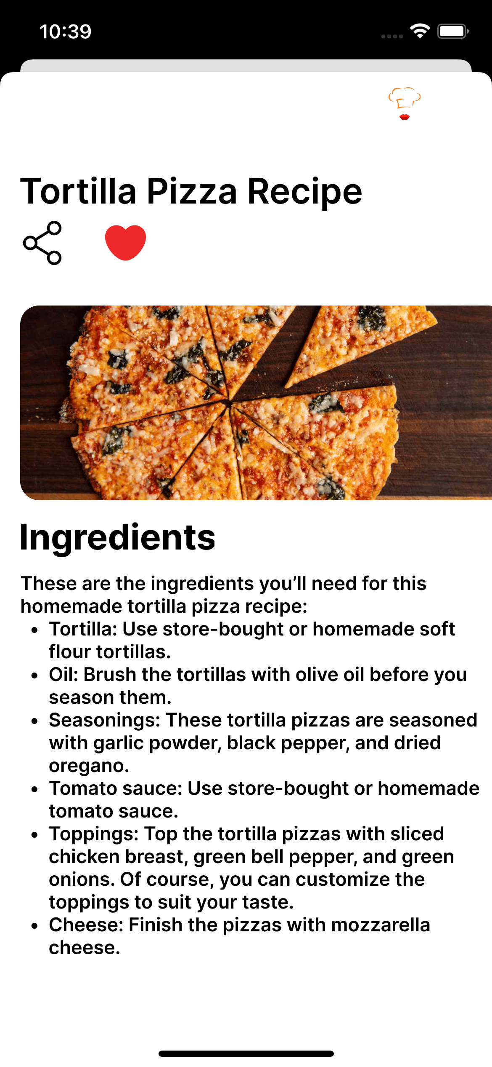

Slide 6
WHAT WE IMPLEMENTED?
We utilized Figma to design 8 screens and then imported them into Zeplin for further use. Following that, we developed the pages in XCode and ensured that proper constraints were applied to each page to ensure their stability and responsiveness.
To ensure independent aspect resolution, we conducted testing of all the screens on various devices such as iPhone 12, iPhone 13, and iPhone 13 Pro.
The code is well-structured, orderly, and has appropriate comments added for clarity and understanding.
During the registration process, we are storing user information such as their name, email, and password using Core Data. Additionally, we have incorporated binary data entities to save image data.
Upon successful login, the user's information is passed to the next view controller where it is displayed as a welcome message. Furthermore, we have converted 3 images from the asset into binary data and saved them in Core Data. This binary data is then loaded in the home view controller for display as images.

Slide 7
THANK YOU!!

